Slide 1
Heating Load and Cooling Load Prediction

Slide 2
Objective:
  Development of a predictive model for estimating the Heating Load and Cooling Load of residential buildings which is affected by the eight input variables. The model will predict the Heating Load and Cooling Load based on the input feature values provided.
Benefits:
  Convenient and accurate approach for Heat Load and Cool Load Estimation.
  Low mean absolute error deviations from the ground truth is achieved.

Slide 3

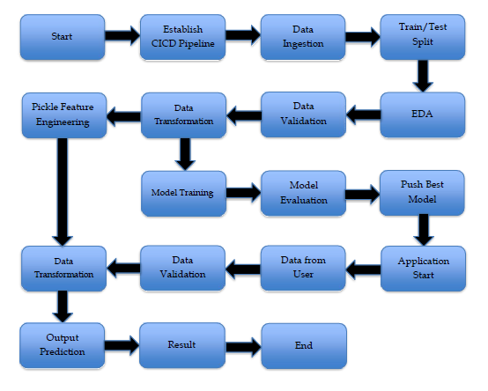

Slide 4
Train/Test Split, Data Validation and Data Transformation :
  Train/Test Split – We have performed the train/test split using Stratified Shuffle Split to have the same kind of data distribution on the training dataset and test dataset.
  Performing EDA to get insight of data like identifying distribution, Null Values, outliers, correlation etc.
  Data Drift – Validation for the presence of Data Drift is been made and the same can be accessed with the report.html from the Data Validation Artifact.
  Data type of columns - The data type of columns is given in the schema file.
  Null values in columns - If any of the columns in a file have all the values as NULL or missing, we have used Simple Imputer to replace any missing with the Median value of the respective feature column.
  Data Transformation – We have standardized the data using Standard Scaler and the same transformation is carried out for test data and new incoming data using the preprocessing object pickle file.

Slide 5
  Model Training –
    Model Training is carried out using training dataset based on the parameters provided in the model.yaml file using GridSearchCV.
  Model Evaluation & Selection –
    Based on the hyper-parameter tuning using GridSearchCV the best model is selected which has the set base accuracy achieved and the difference between train accuracy and test accuracy less. Linear Regression, Ridge, Lasso Regression, Elastic Net, Random Forest regressor were the algorithms passed and the best Model chosed was “Random Forest Regressor”.

Slide 6
Prediction:
  The testing files are shared in as a single unit/batches and we perform the same data pre-processing, Validation operations and data transformation on them using the preprocessing object pickle file.
  The input parameters are passed for the two output features prediction.
    Once the prediction is done the result of the Heating Load and Cooling Load is displayed along with the given input feature parameters.

Slide 7
Q & A:
Q1) What’s the source of data?
  The data for training is taken from UCI Machine Learning Repository.
  Q 2) What was the type of data?
  The data comprised of eight input features and two output features which were all numerical values.
  Q 3) What’s the complete flow you followed in this Project?
  Refer slide 3 for better Understanding

Slide 8
Q 4) How logs are managed?
We have provided logs for each stage in the pipeline and the same is been captured with the stage name start/end along with the respective timestamp.
Q 5) What techniques were you using for data pre-processing?
  Visualizing relation of independent variables with each other and output variables
  Checking and changing Distribution of continuous values
  Removing outliers
  Cleaning data and imputing if null values are present.
  Scaling the data

Slide 9
Q 6) How training was done or what models were used?
We have performed train/test split using Stratified Shuffle Split to ensure the data distribution is same in train dataset and test dataset.
The scaling was performed over training and test data
Algorithms like Linear Regression, Lasso, Ridge, Elastic Net, Random Forest Regressor were used based on the r2_score, mean squared error final model was selected and we saved that model.
Q 7) How Prediction was done?
We have made use of test data for prediction. We Perform the same transformation using the preprocessing pickle file and in the end with best model selected we get the predicted data.
Q 8) What are the different stages of deployment?
We have initially established CICD pipeline using Git < GitHub Actions < Heroku using docker.

